Slide 1
Lecture 24 – AVL Trees
CST370 – Design & Analysis of Algorithms
Dr. Byun
Computer Science

Slide 2
Lecture Objectives
After completion of this lecture, you will be able to
  recognize the problem of skewed binary search tree and explain the idea of balanced search tree.
  perform four different rotations to insert a new node into an AVL tree.

Slide 3
Chapter 6: Transform-and-Conquer
6.1 Presorting
6.2 Gaussian Elimination
6.3 Balanced Search Trees
6.4 Heaps and Heapsort
6.5 Horner’s Rule and Binary Exponentiation
6.6 Problem Reduction

Slide 4
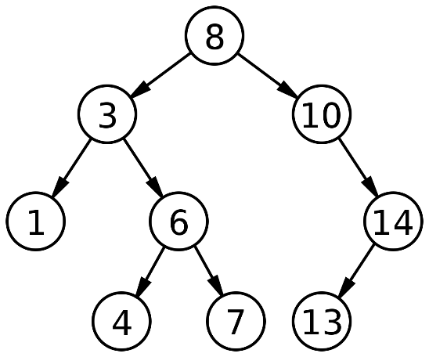
Binary Search Tree
Binary search trees provide efficient insert, delete, and search operations.
Example

Slide 5
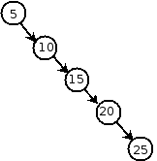
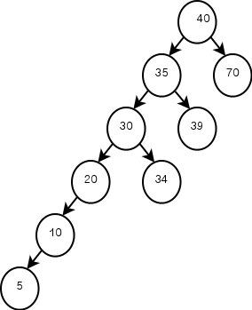
Binary Search Tree – Issue
One problem with binary search trees is that if the tree is too unbalanced (= skewed), the operation can take linear time (= O (n)).
Example
Source: http://epaperpress.com/sortsearch/bin.html

Slide 6
AVL Tree
The AVL tree is a balanced binary search tree and the difference in height between the left and right subtrees is less than or equal to 1.
  The difference is called balance factor (or balancing factor).

Slide 7
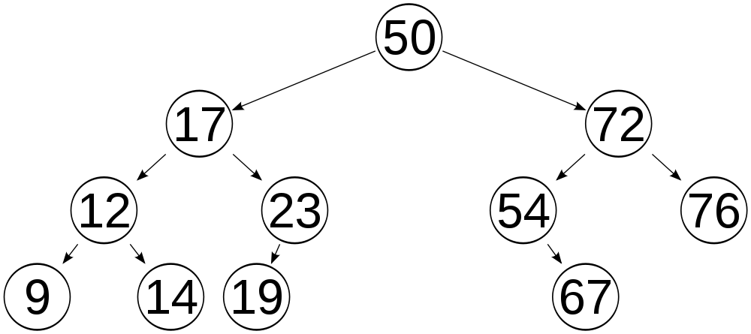
AVL Tree – Example

Slide 8
<<< Course Instruction >>>
Watch this video from 11:08 to the end.
  http://y2u.be/f4sJ5dOeOow
    It will take about 7 minutes to watch from 11:08 to the end.
  This video explains the definition of balancing factor in detail.

Slide 9
AVL Tree – Example

Slide 10
Exercise (1 of 2)

Slide 11
Exercise (2 of 2)

Slide 12
Rotations
A rotation is a local transformation of a subtree whose balance factor has become either +2 or -2.
  In other words, after inserting a new node, if the AVL tree becomes unbalanced, it will be rotated to balance it.

Slide 13
Four Types of Rotations
R-rotation
L-rotation
LR-rotation
RL-rotation

Slide 14
<<< Course Instruction >>>
Watch this video to understand how the four rotations are executed.
  http://y2u.be/msU79oNPRJc
  It’s a little bit difficult concept, especially LR and RL rotations.
It will take about 17 minutes to watch the whole video.
  But I will give you 22 minutes to watch it.

Slide 15
Single Right Rotation: R-Rotation

Slide 16
Single Left Rotation: L-Rotation

Slide 17
Double Left-Right Rotation: LR-Rotation

Slide 18
Double Right-Left Rotation: RL-Rotation

Slide 19
Exercise (1 of 2)

Slide 20
Exercise (2 of 2)

Slide 21
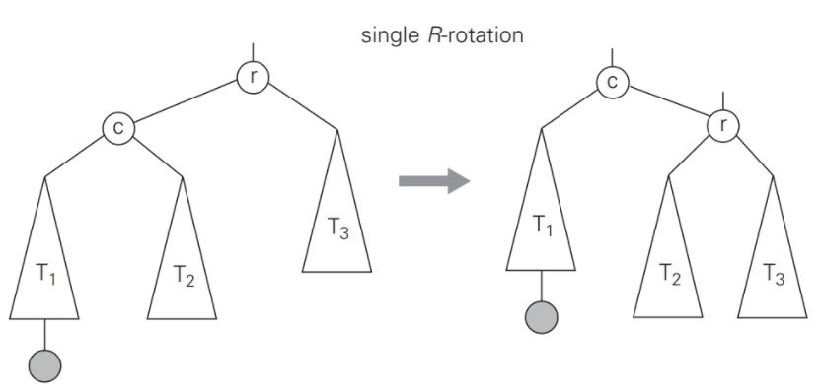
General Case: R- Rotation

Slide 22
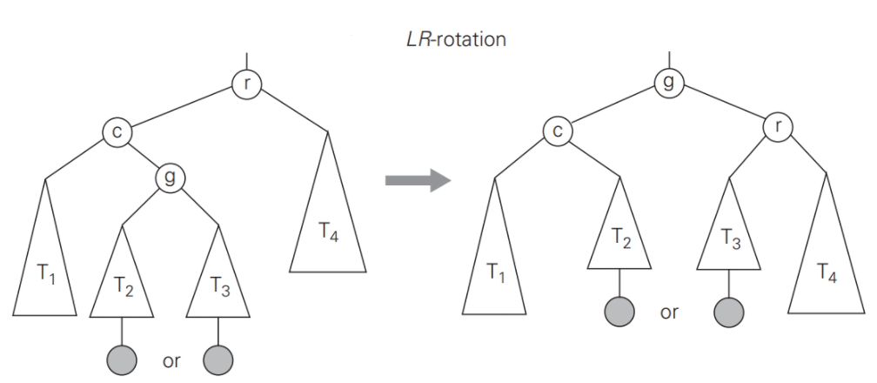
General Case: LR- Rotation

Slide 23
AVL Tree Construction – Example (1 of 2)

Slide 24
AVL Tree Construction – Example (2 of 2)

Slide 25
Exercise (1 of 2)

Slide 26
Exercise (2 of 2)

Slide 27
Additional Resource
Watch this video to understand how multiple rotations can be conducted in the AVL tree.
  http://y2u.be/GSt_mo60WuE

Slide 28
Analysis of AVL Trees

